Slide 1
Ready to Register
Sociology Advising
Welcome New Transfers
*These slides, content and additional resources can be found on our website.

Slide 2
Getting Ready to Register
Create a Balanced Schedule
Sociology Major Requirements
Other requirements:
GPE & Writing Intensive (WI) course
General Education (GE) Requirements
Unit Requirements & General Electives
Using the ARR & Class Search/Enroll How-to Guide

Slide 3
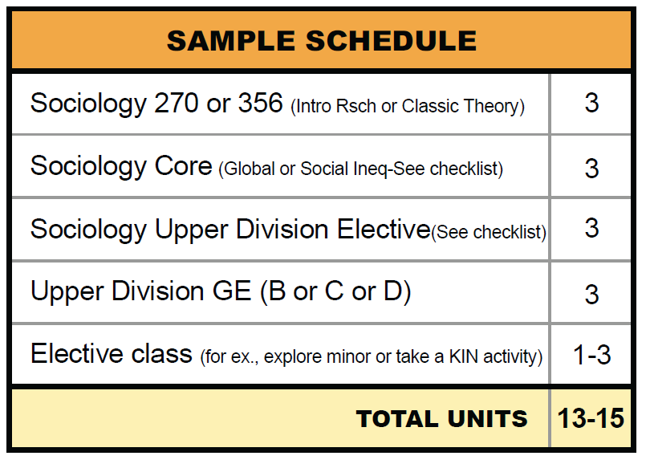
Create a Balanced Schedule
Balance Major, GE, & Electives
Max 3 Sociology classes
Upper Division GE
General elective (units) or explore a minor
Notes:
https://docs.google.com/presentation/d/1sQJBzydw_mCZLPOCciuEsbsnIg7NwrjU/edit#slide=id.p3

Slide 4
Create a Balanced Schedule
How many classes?
15 units per semester = 60 units in two years
Number of classes (units) is how you progress toward graduation
Know your total units (toward 120 needed)
Consider your circumstances (work, family, etc.)
Take the number of classes that is right for you

Slide 5
Create a Balanced Schedule
Online or In-person?
Some non-SOC online (listed as “online only”)
Synchronous scheduled Zoom meeting
Day/times listed
Asynchronous without scheduled meetings
No day/times listed

Slide 6
Sociology Major Requirements
Total of 41 Units (13 classes) Seven Required Classes (23 units):
Soc 100: Principles of Sociology
Soc 142: Social Problems
Soc 170: Elementary Statistics
Soc 270: Intro to Rsch Methods
Soc 354/355: Qual/Quant Methods
Soc 356: Classical Theory
Soc 357: Modern Theory
Two Core Classes (6 units):
Select one class from each core area:
Global Perspectives
Social Inequalities & Social Change
Four Upper Division Electives (12 units):
Focus or choose breadth

Slide 7
Sociology Major Requirements
Methods Sequence: SOC 170 → SOC 270 → SOC 354 or 355
Take these three in order
Theory Sequence: SOC 356 → SOC 357
Take these two in order
Sociology Core & Upper Division Electives:
SOC classes can only meet one requirement for major
(no double-counting inside the major)

Slide 8
GPE & Writing Intensive (WI) Requirement
Graduation Writing Assessment Requirement (GWAR) has two parts:
GWAR Placement Exam (GPE)
Writing Intensive (WI) class
Must take GPE before WI class
WI class does not need to be in sociology
Sign up on the GWAR website
*Next deadline is January 26th

Slide 9
General Education (GE) Requirements
Most/all lower division GE done prior to transfer
Upper Division (UD) GE required for all*
UD GE categ B: Quantitative/Scientific Reasoning
UD GE categ C: Humanities
UD GE categ D: Social Sciences
*UD GE varies by catalog year; see your Academic Requirements Report
*Use Schedule of Classes and search by GE Category
*See instructions on searching on SOC Advising

Slide 10
Unit Requirements & General Electives
University requires 120 units total/ 40 units Upper Div
Units not filled by major, GE (or minor) must be completed with electives
General Electives do not need to be in Sociology
Some electives may need to be Upper division
Track unit requirements on Academic Requirements Report
Consider using electives to balance schedule

Slide 11
Unit Requirements & General Electives
University requires 120 units total/ 40 units Upper Div
EXAMPLE 1
Student transfers with 60 units
Needs 31 units in SOC + 12 units GE/WI = 43 units
60 (xfer) + 43 (SOC/GE) = 103
Student will need at least 17 units (6-7 classes) of general electives to reach 120 units

Slide 12
Unit Requirements & General Electives
University requires 120 units total/ 40 units Upper Div
EXAMPLE 2: you try it
Student transfers with 64 units
Needs 28 units in SOC; 9 units GE/WI plus 15 units for a minor (taking WI in minor)
How many units of electives?
64+28+9+15 = 116
Student will need about 4 units general elective

Slide 13
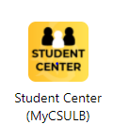
Using the ARR & Class Search How-to Guide
Link: Using Your Academic Requirements Report
Link: How to Search for GE classes

Slide 14
QUESTIONS?

Slide 15
Frequently asked questions:
How can I change my schedule?
You may change your schedule on MyCSULB starting on your registration date
Registration Hold on SOAR date until completed
ADD/DROP allowed through 1st two weeks of semester (no “W” on transcript)
After that, signatures required to Withdraw with “W”

Slide 16
Frequently asked questions:
“Double-counting” classes
Some classes can meet requirements for both Sociology and General Education requirements
Example: Two “checkmarks” with 3 units
Class meets two requirements but provides total of 3 units toward unit requirement
No double-counting within Sociology

Slide 17
Frequently asked questions:
Planning when you will graduate
How many total units do you need?
How many units will you take per semester?
Example 1:
60 units @ 15 per semester = 4 semesters
Example 2:
60 units @ 12 per semester = 5 semesters

Slide 18
Frequently asked questions:
Graduation is when you complete all requirements
Apply during semester prior to grad
Commencement is celebration in May

Slide 19
Sociology Advising
Sociology Drop-in Advising on Zoom - Schedule: http://cla.csulb.edu/departments/sociology/advising/
Email:
Sociology.Advising@csulb.edu
Sociology Advising not available during Winter Break (Contact ATLAS for help)
Spring 2024 Dr. Steven Osuna
Dr. Varisa Patraporn
Dr. Esa Syeed

Slide 20
LINKS
Additional Links:
Sociology Department
Sociology Advising
Sociology MAJOR Checklist
CSULB Sociology Alumni Profiles
American Sociological Association

Slide 21
Advising HOLDS
Advising holds will be lifted automatically on your Advising & Registration Date

